Slide 3
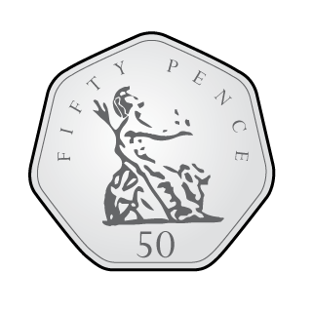
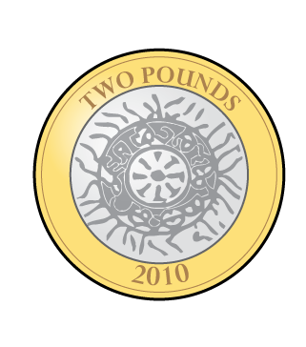
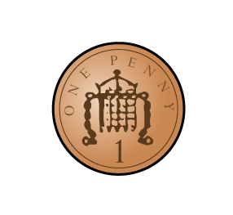
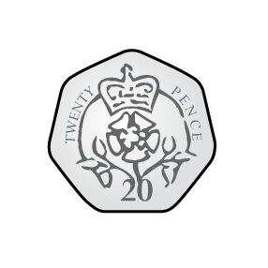
Ron has these coins. He spends 52p.
How much does he have left?
2) What is £1 subtract 20p?
3) What is £1 subtract 25p?
4) Complete the additions to make £1 each time
60p $+$ p $=$ £1 70p $+$ p $=$ £1
p $+$ 65p $=$£1 p + 85p = £1

Slide 4
Ron has these coins. He spends 52p.
How much does he have left?
2) What is £1 subtract 20p?
3) What is £1 subtract 25p?
4) Complete the additions to make £1 each time
60p $+$ p $=$ £1 70p $+$ p $=$ £1
p $+$ 65p $=$£1 p + 85p = £1
£2 and 21p
80p
75p
40
30
35
15

Slide 6
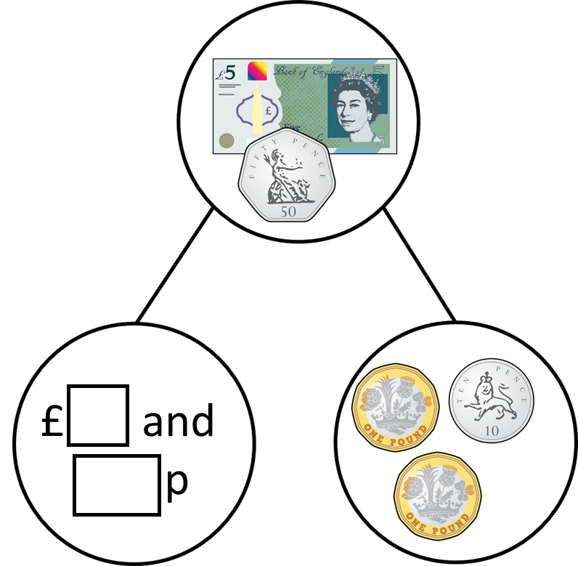
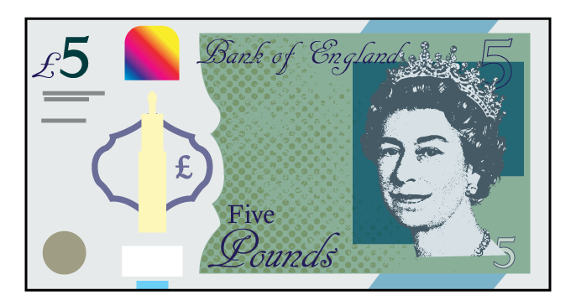
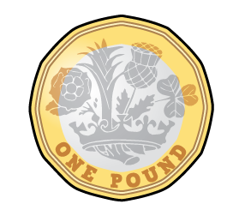
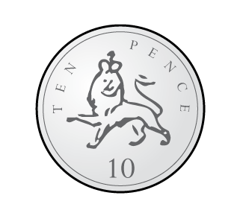
Complete the part-whole model.
3
40
I will exchange the £5 and 50p

Slide 7
Complete the part-whole model.
I will subtract the pounds then subtract the pence.
3
40
£5 and 50p $−$ £2 $=$ £3 and 50p
£3 and 50p $−$ 10p $=$ £3 and 40p

Slide 8
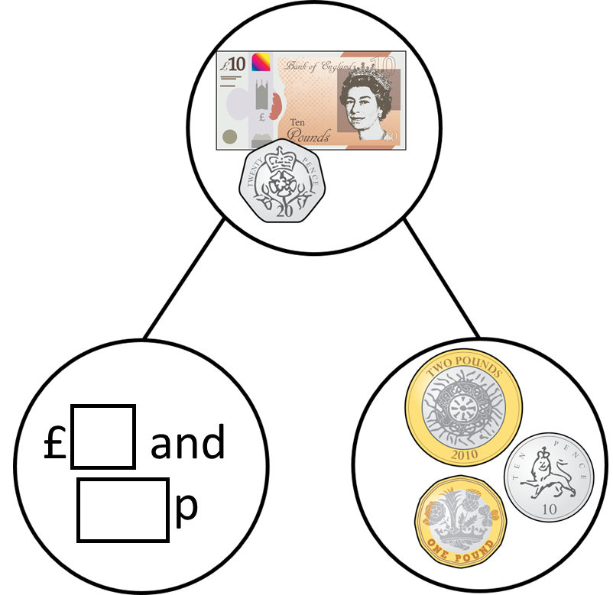
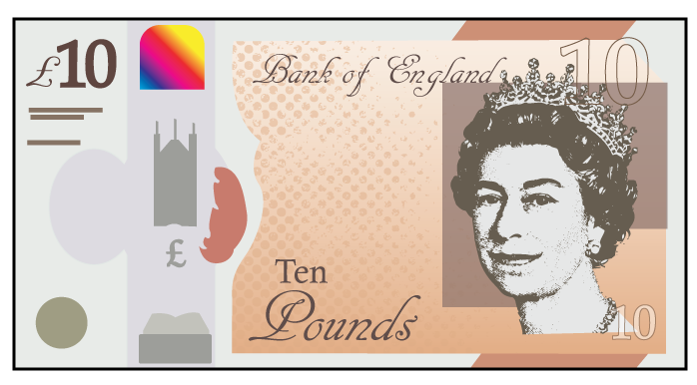
Complete the part-whole model.
Have a think
7
10
I will exchange the £10 and 20p

Slide 9
Complete the part-whole model.
I will subtract the pounds then subtract the pence.
7
10
£10 and 20p $−$ £3 $=$ £7 and 20p
£7 and 20p $−$ 10p $=$ £7 and 10p

Slide 10
Have a go at questions 1 – 4 on the worksheet

Slide 11
Ron is using a number line to subtract £3 and 65p from £5
$−$ 5p
$−$ 60p
$−$ £3
£1 and 35p
£1 and 40p
£2
£5
£5 $−$ £3 and 65p $=$ £1 and 35p

Slide 12
£5 $−$ £3 and 65p
I can count up to find the difference
$+$ 35p
$+$ £1
£3 and 65p
£4
£5
The difference is £1 and 35p

Slide 13
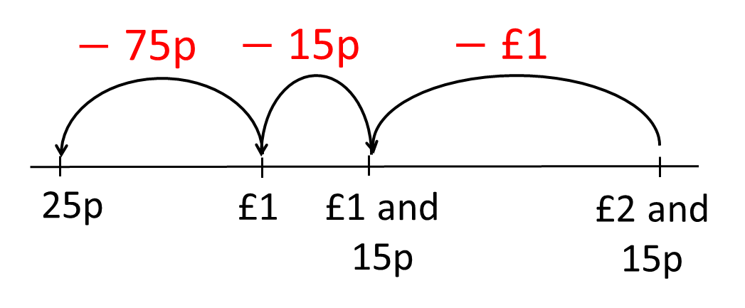
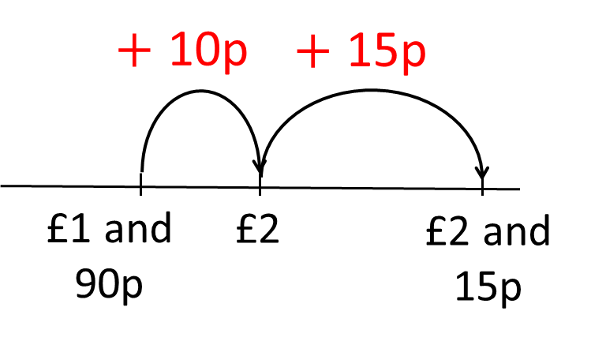
Complete the bar model.
£2 and 15p
£1 and 90p
25p

Slide 14
£5 and 30p
£4 and 85p
45p
When the whole amount and the known part have a small difference, it is usually easier to count up.
Have a think
£5 and 30p
45p
£4 and 85p
When the whole amount and the known part have a large difference, it is usually easier to takeaway the part we know.

Slide 15
Have a go at the rest of the questions on the worksheet

