Slide 1
Tuesday 9th February 2021
OLI: To recognise how people give Glory to God: The Gloria

Slide 4
After the priest has greeted everyone there is the opportunity to say sorry for anything we may have done wrong. This is called the Penitential Act. It prepares the parish family for the celebration of the Eucharist. The response to God’s mercy and forgiveness is a song of praise called the Gloria, a prayer praising and glorifying God which also prepares people for listening to God’s Word. The first words remind us of the heavenly message to the shepherds when Jesus was born, Glory to God in the highest.

Slide 5
The Gloria
Glory to God in the highest

Slide 6
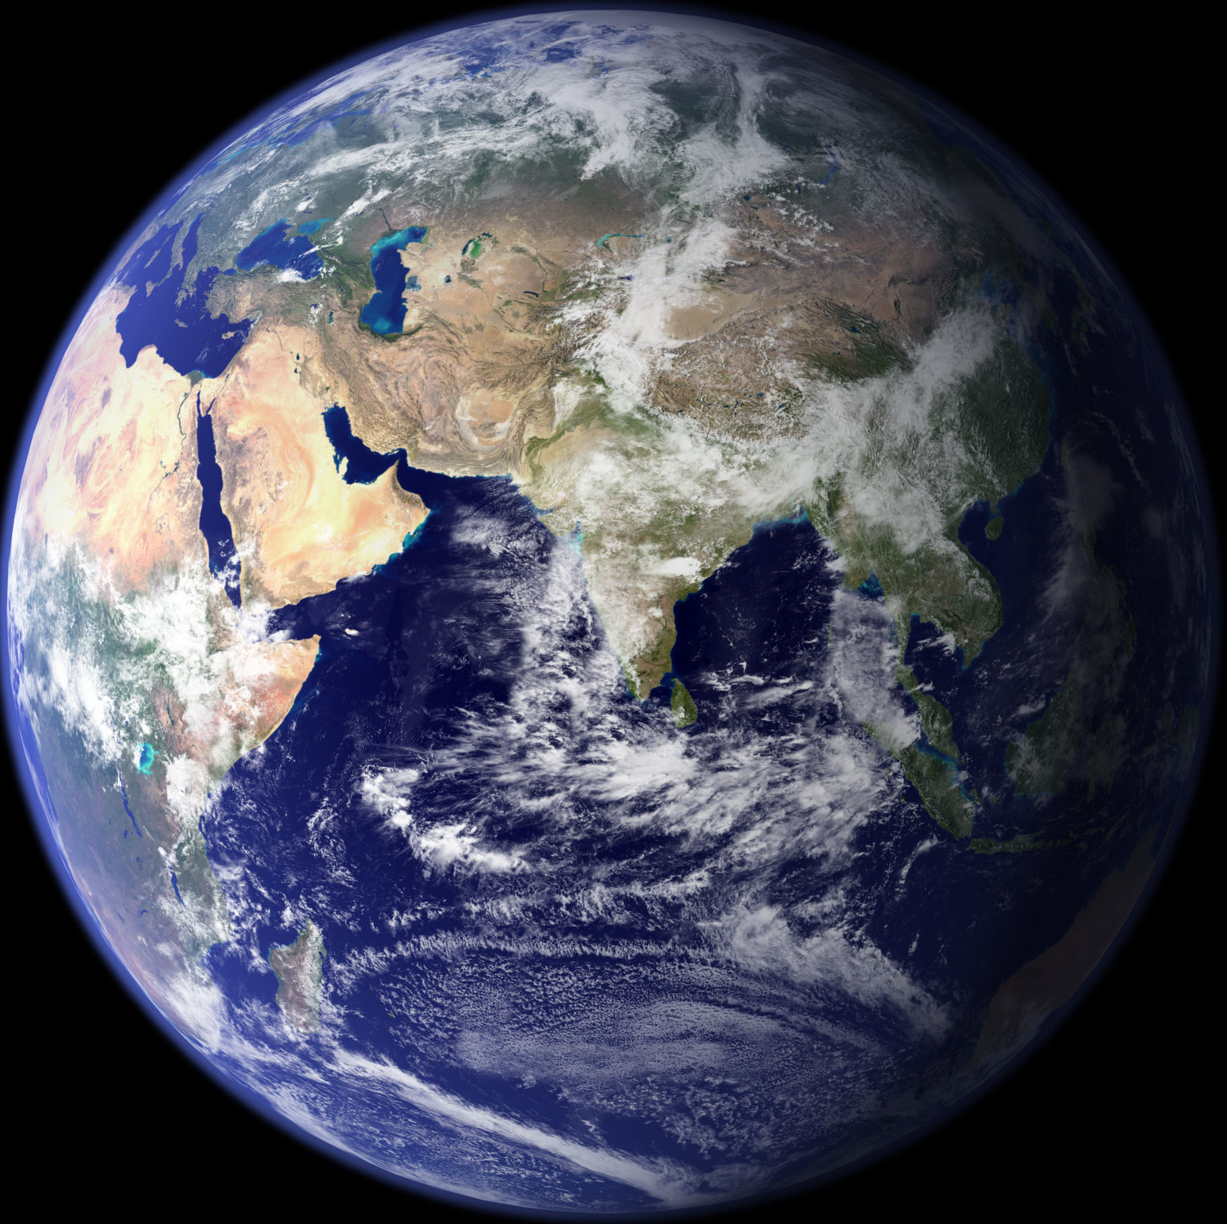
Glory to God in the highest,
And on earth peace to people of good will.

Slide 7
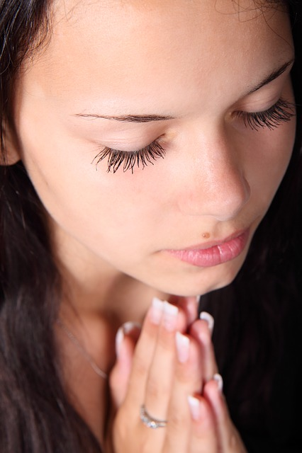
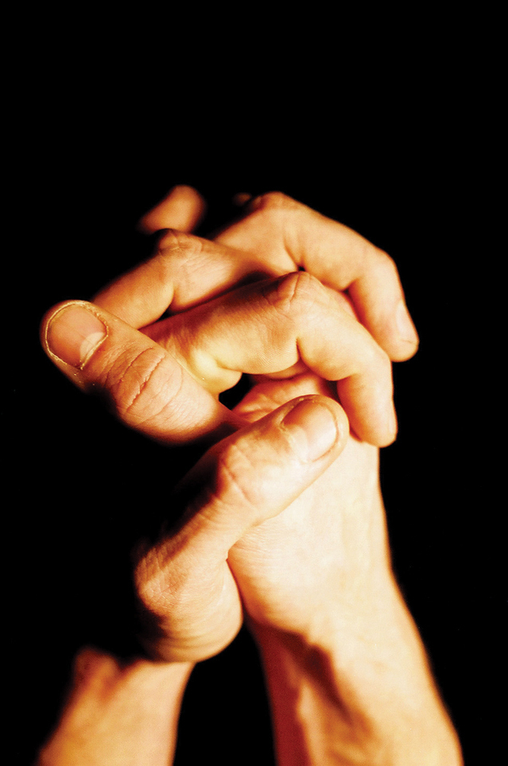
We praise you,
We bless you,
We adore you,
We glorify you,
We give thanks for your great glory,
Lord God, heavenly King,
God, almighty Father.

Slide 8
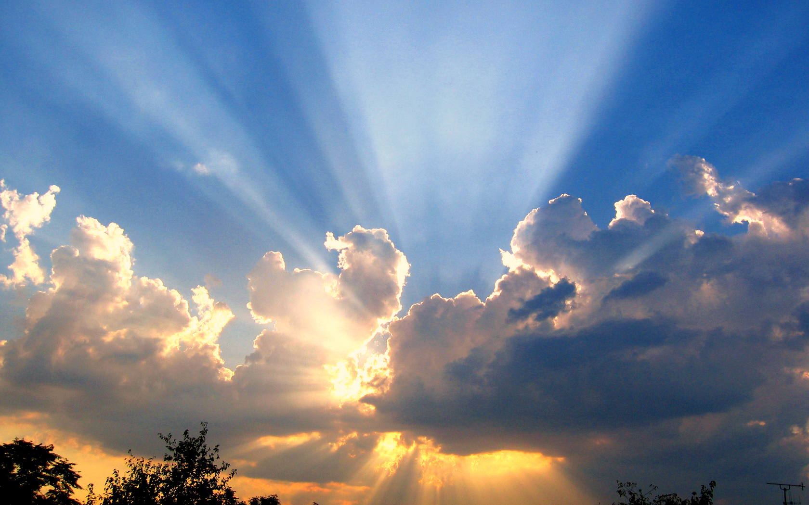
Lord Jesus Christ, Only Begotten Son,
Lord God, Lamb of God, Son of the Father,
You take away the sins of the world, have mercy on us;
You take away the sins of the world, receive our prayer;
You are seated at the right hand of the Father, have mercy on us

Slide 9
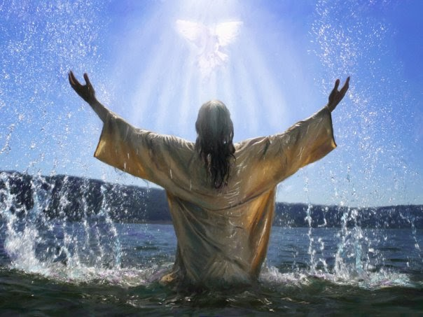
For you alone are the Holy One,
You alone are the Lord,
You alone are the Most High, Jesus Christ,
With the Holy Spirit, in the glory of God the Father.
Amen.

Slide 10
SOME KEY QUESTIONS
Why is the Gloria said after the Penitential Act?
What makes you think of the Christmas story when you hear the first words?
Why do Christians want to give glory to God?
Which are your favourite lines of the Gloria and why?
What does it say about God and about Jesus Christ?
How do you think praying the Gloria makes people feel?

Slide 11
Choose the words in the Gloria that you like best. Write about why you like them and how these words might prepare people to listen to God’s Word.

