Slide 1
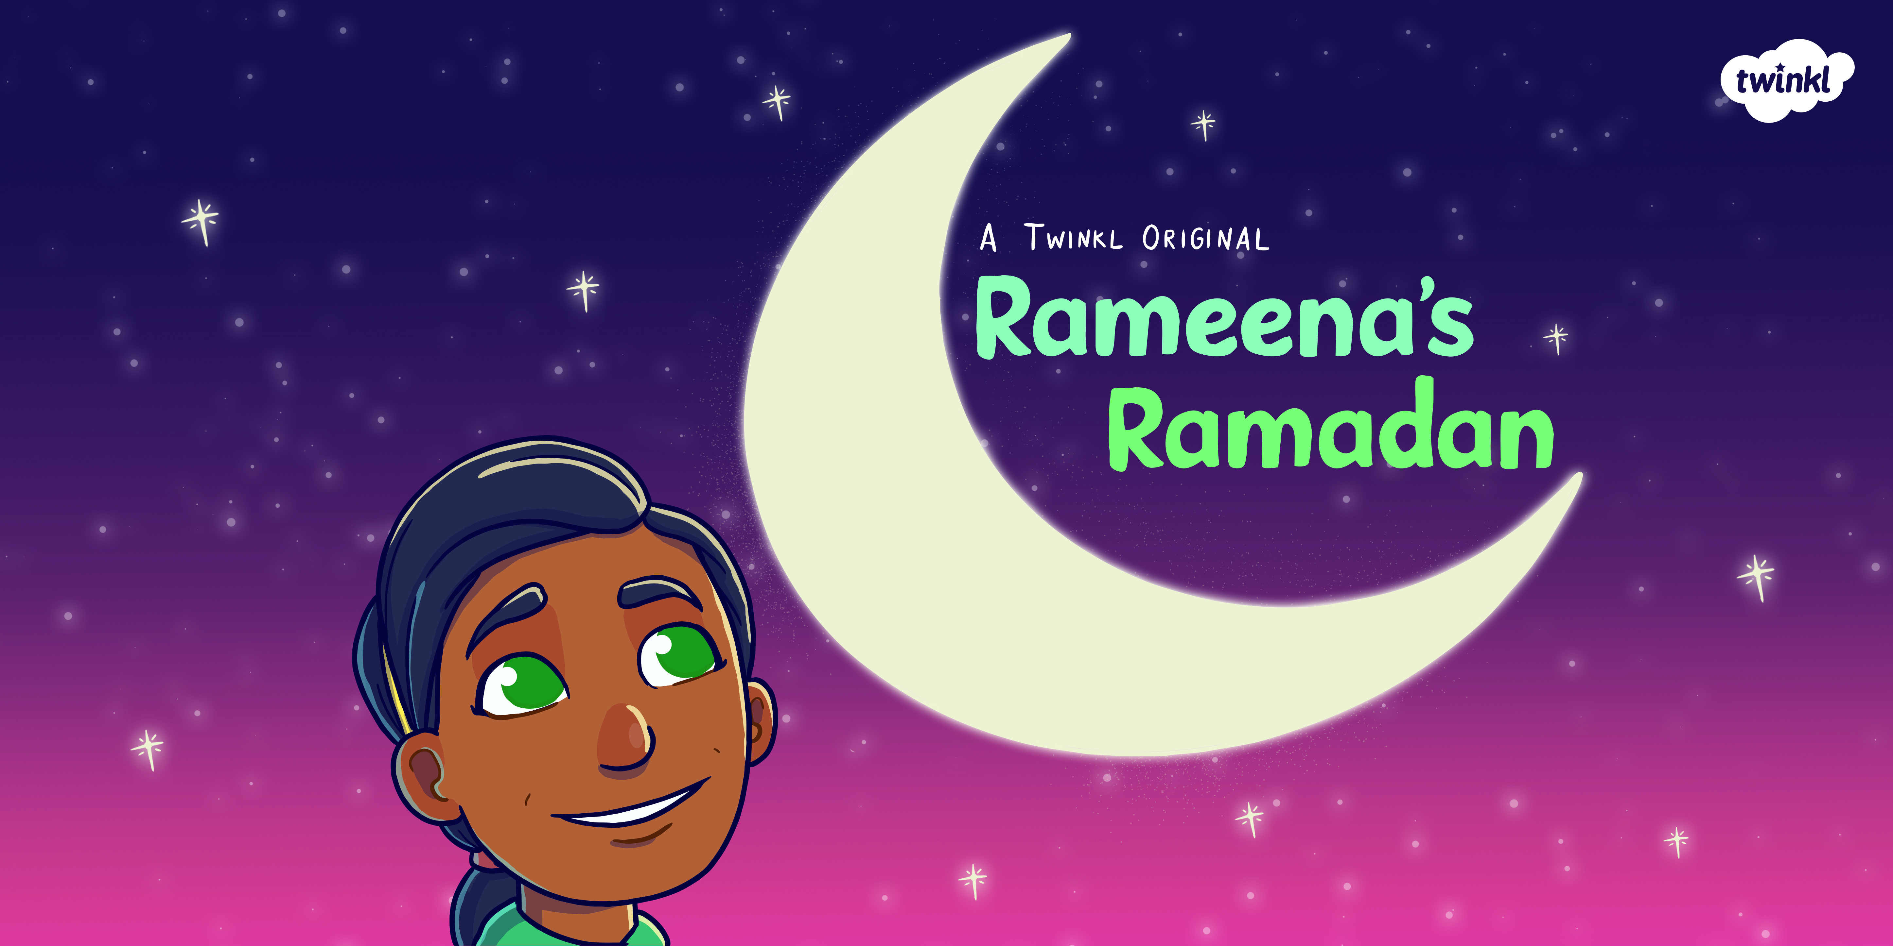

Slide 2
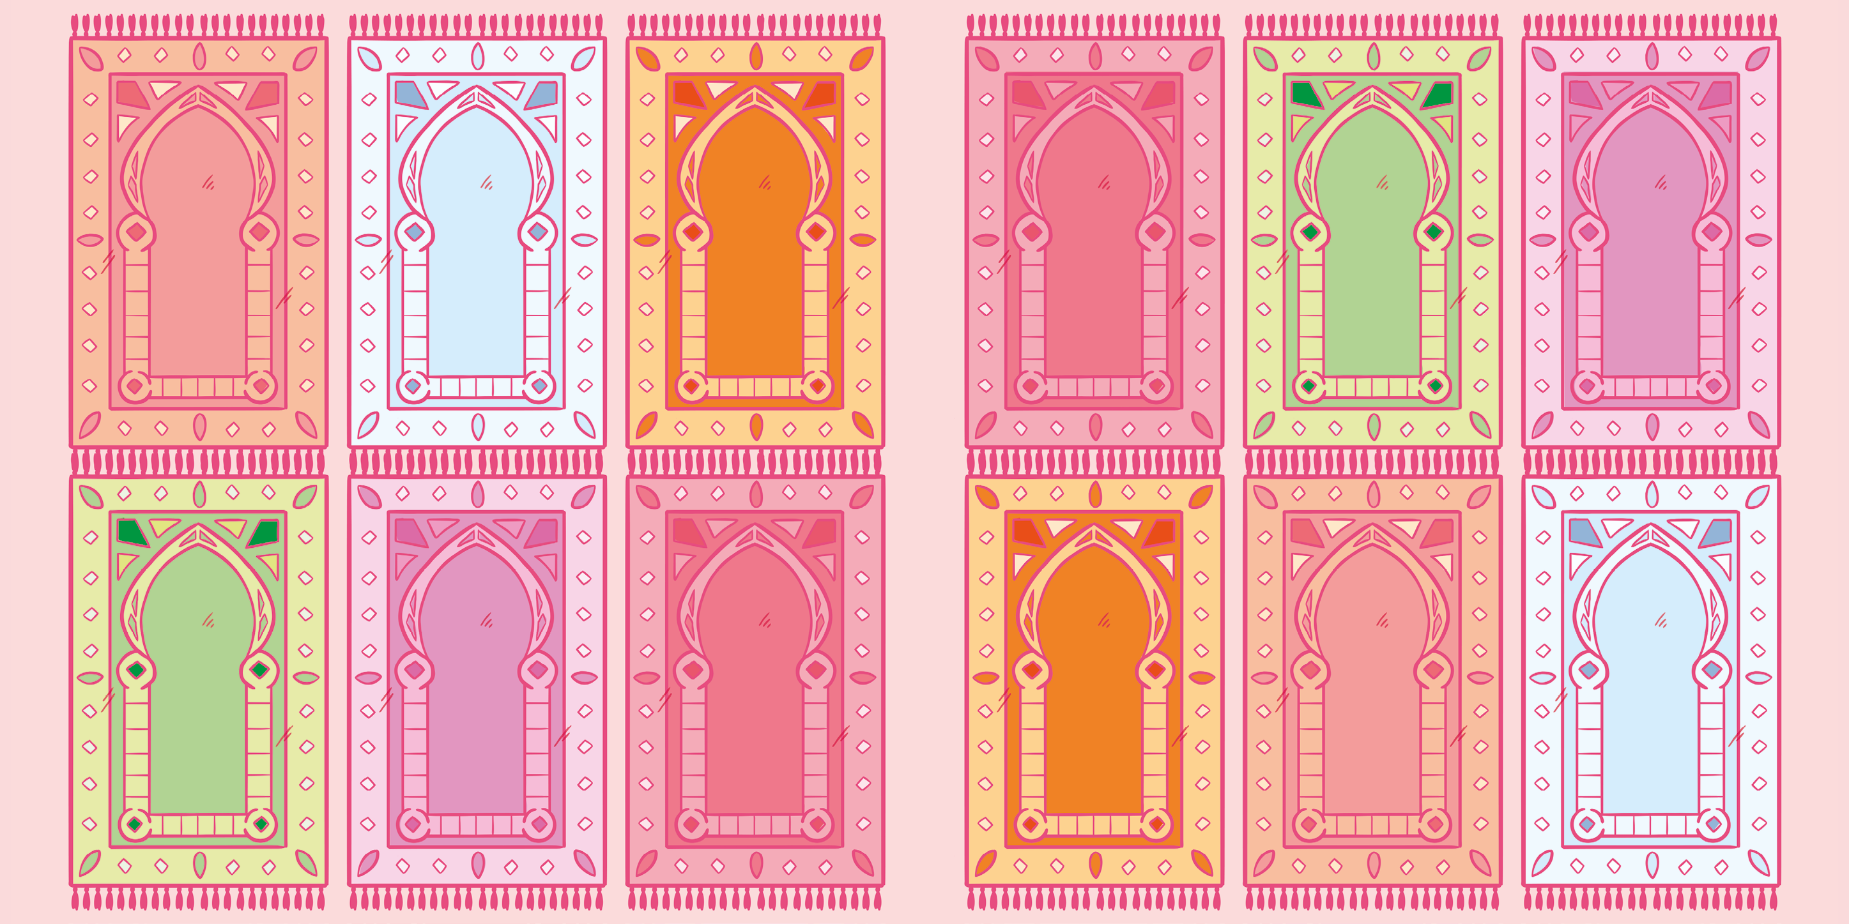

Slide 3
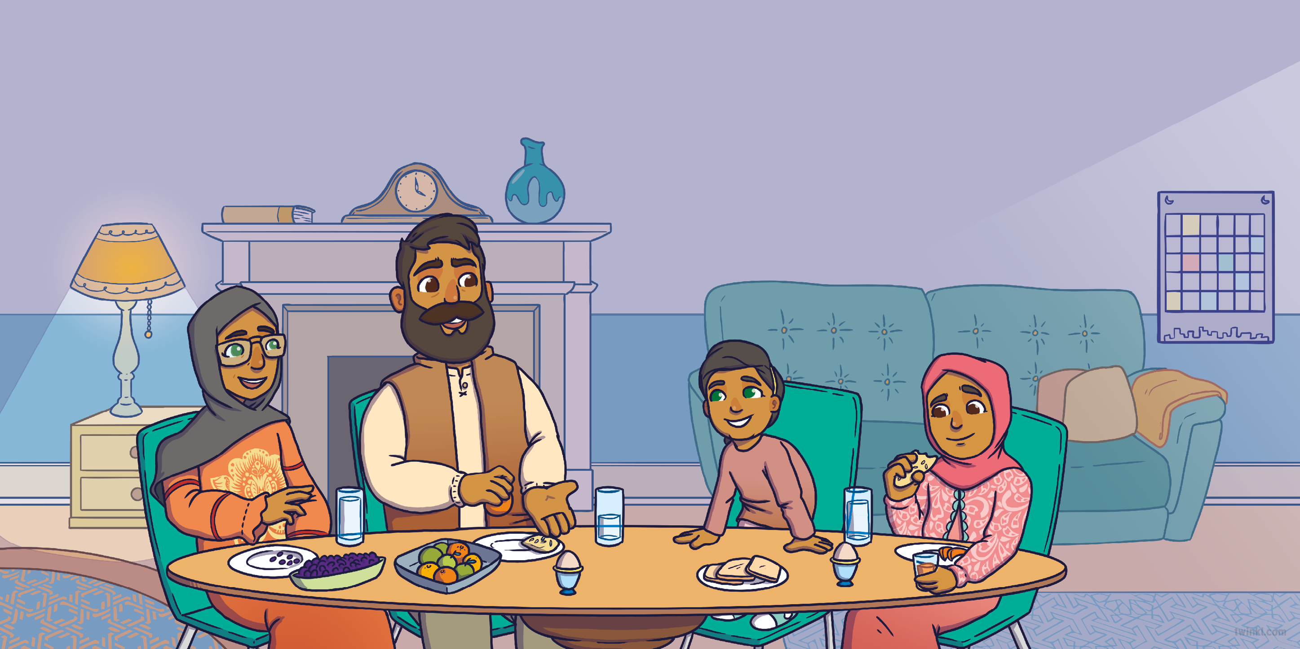
It was very early in the morning when Rameena joined her family in the living room. Mum, Dad and Zenab were eating bread, eggs and fruit for Suhoor.
“It’s wonderful that you want to take part,” said Mum, “but you’re still too young to fast all day. You can join us for
a little while before you go back to bed.”
“Can I fast, too?” asked Rameena.
Rameena sat next to Zenab and smiled
as Dad passed her some fruit.

Slide 4
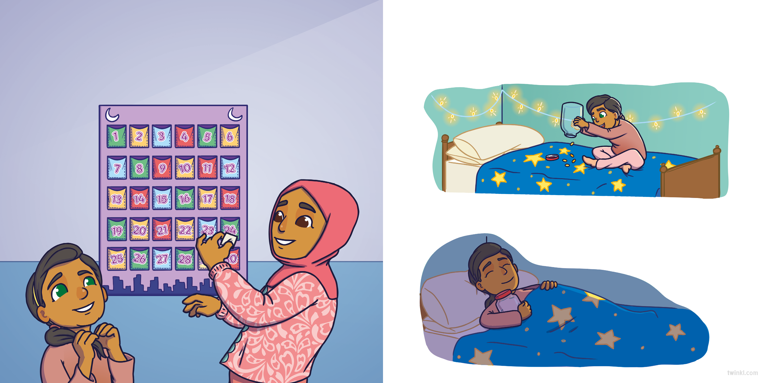
After they had eaten, Zenab helped Rameena to reveal the final message in her Ramadan calendar.
Rameena knew just what to do. She rushed up to her room to check her money jar. “I’ll find someone to give this money to,” she said.
“Give to others,” read Zenab.
She fell back to sleep, dreaming of how she could use her money to help others.

Slide 5
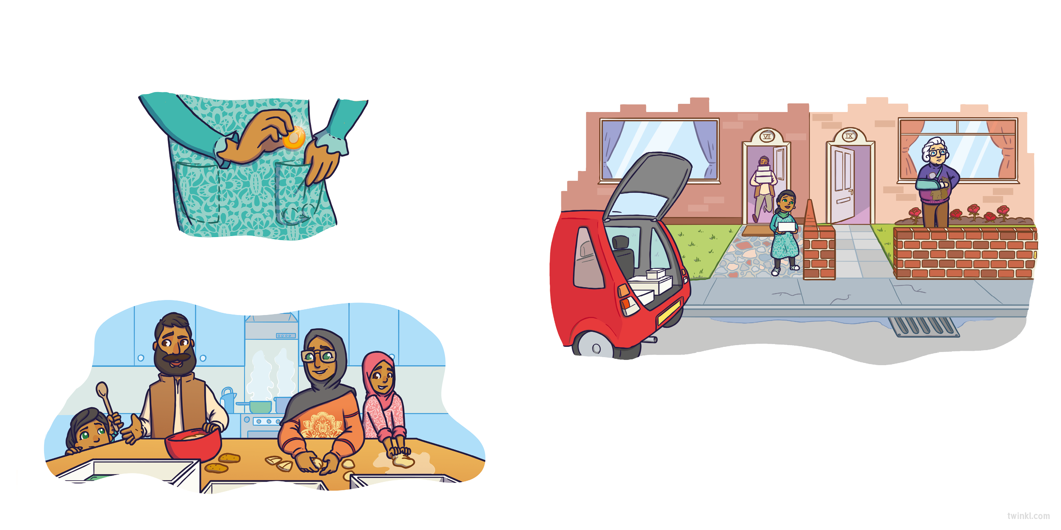
Later that morning, Rameena got ready for the
day, putting the money safely in her pocket.
As they loaded all the tins and trays of food into the car, Rameena spotted their neighbour, Pam, in her garden.
Downstairs, she helped her parents make lots of
delicious food to take to the community centre.
“Hi!” called Rameena. “Are you OK?”
“I’m fine,” said Pam. “I’m just worried about my beautiful plants. I haven’t been able to do any gardening since I broke my arm.”

Slide 6
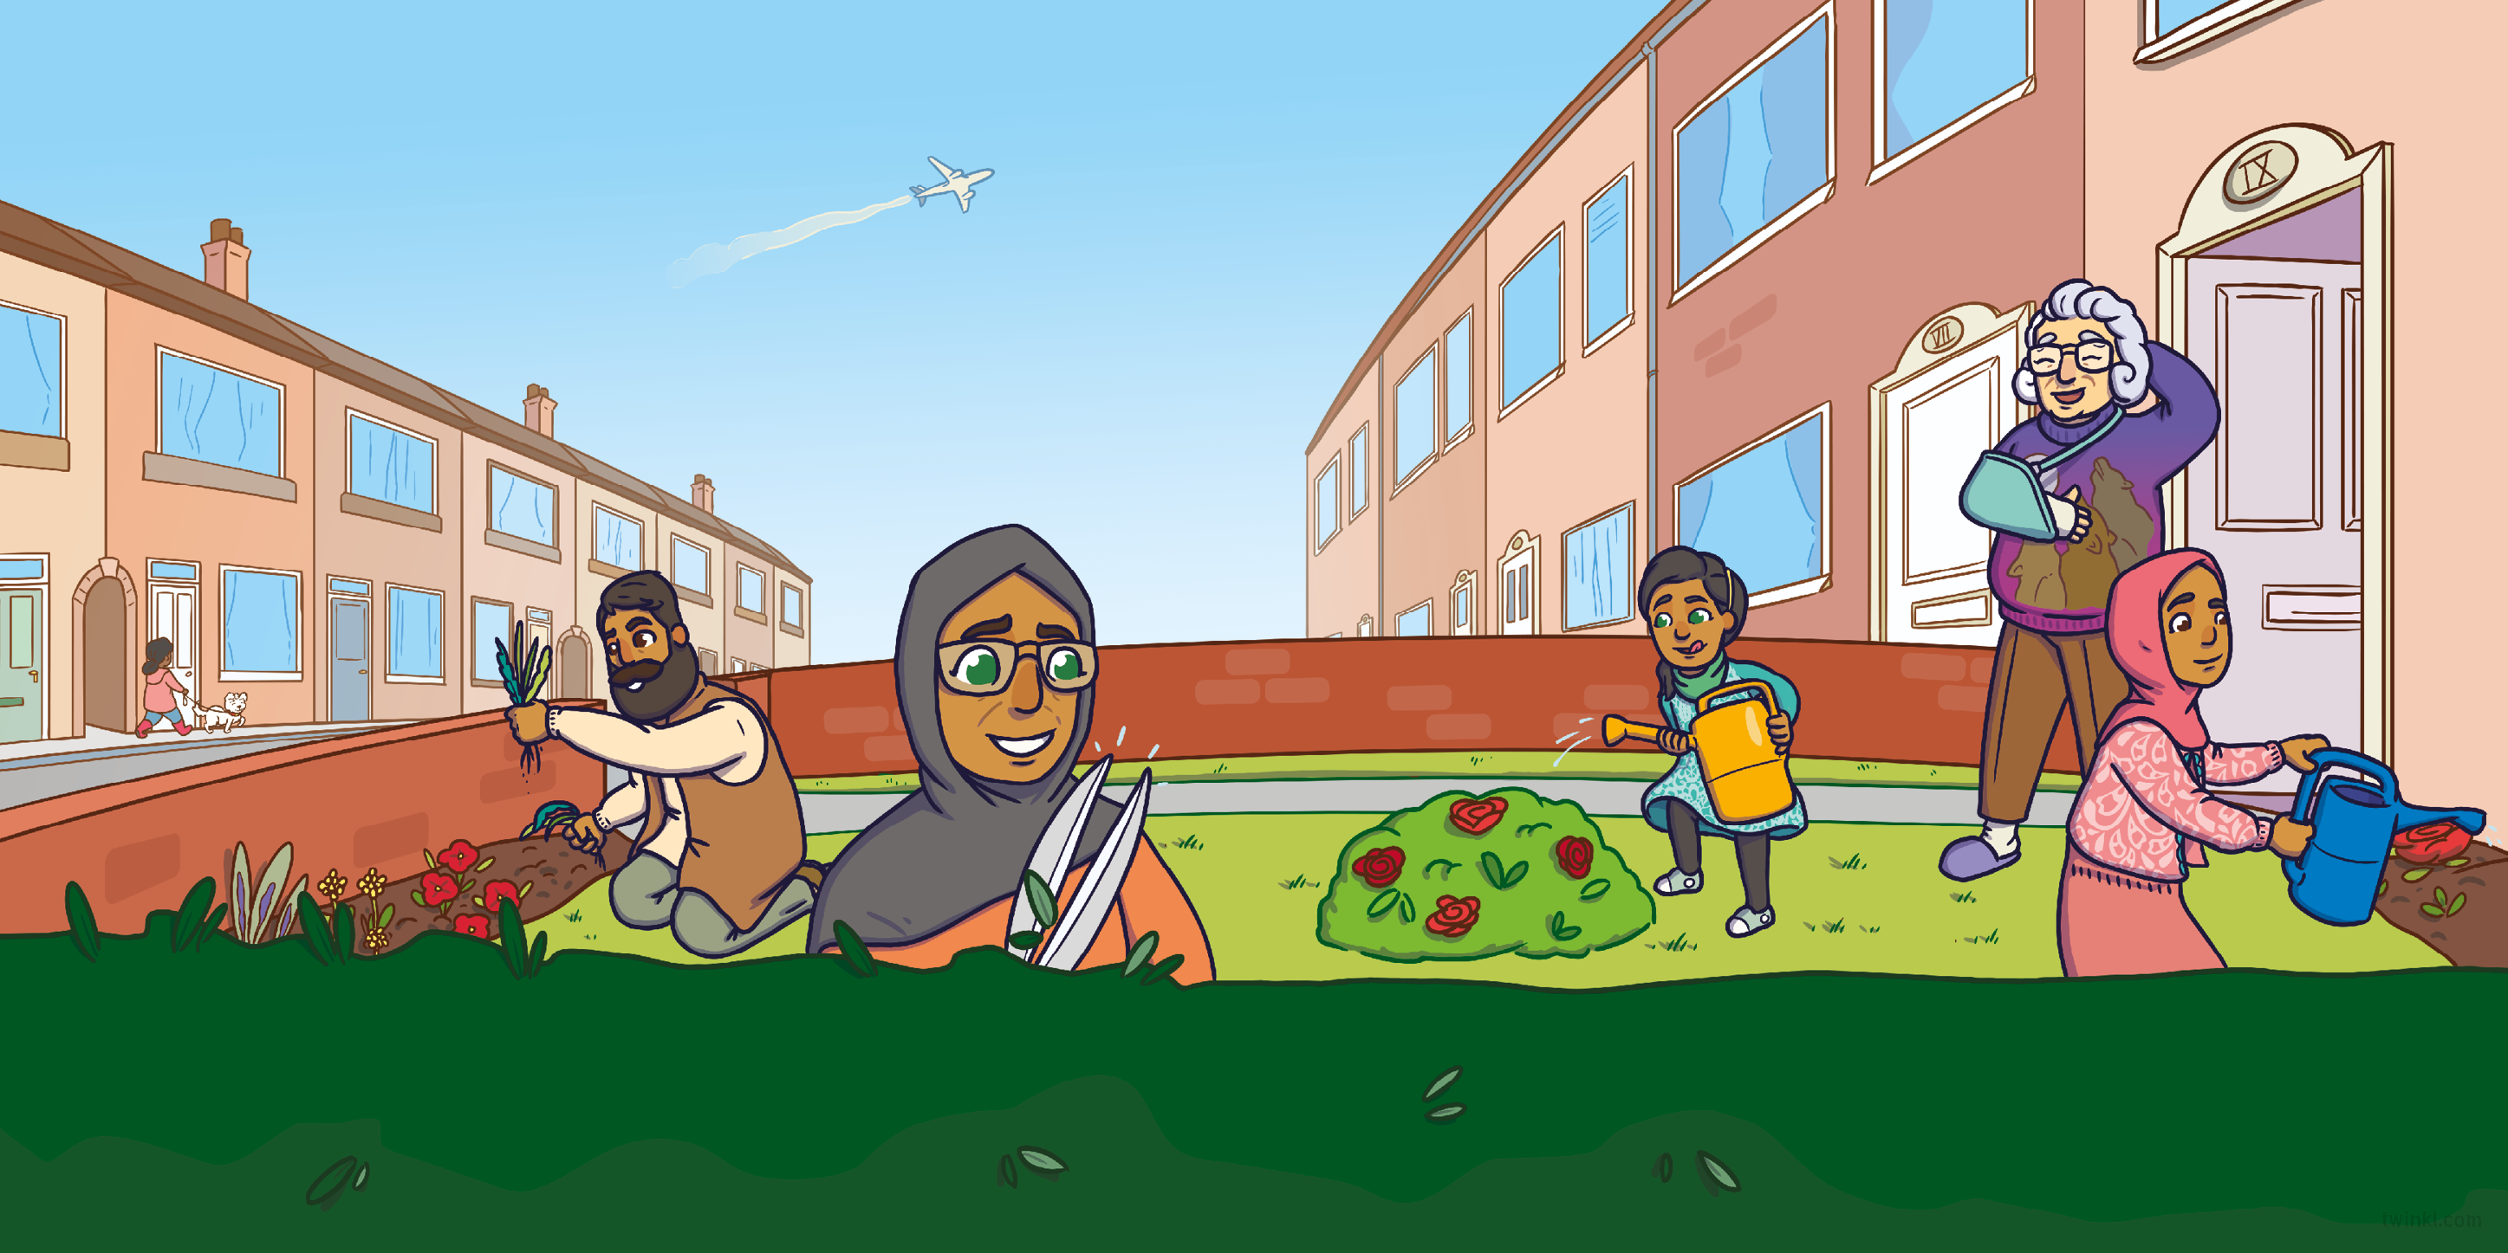
“Don’t worry,” said Rameena. “We can sort out your garden in no time.”
Rameena and Zenab watered the flowers, while Mum and Dad pulled up all the weeds and trimmed the hedges.
“Oh, thank you,” said Pam. “That was so kind of you. I hope you have a lovely Eid.”

Slide 7
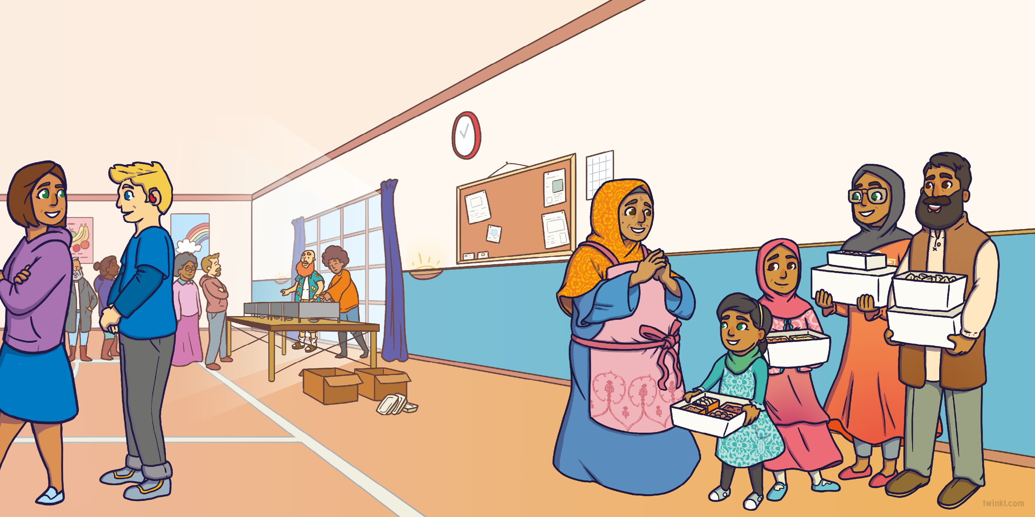
Next, the family went to meet Mrs Hussain at the community centre and donated all of the food they had prepared.
“Wow!” said Mrs Hussain. “This all looks very tasty. We’ve been able to help so many people already today but there’s still so much to do.”
“Don’t worry,” said Rameena. “We can stay and help!”

Slide 8
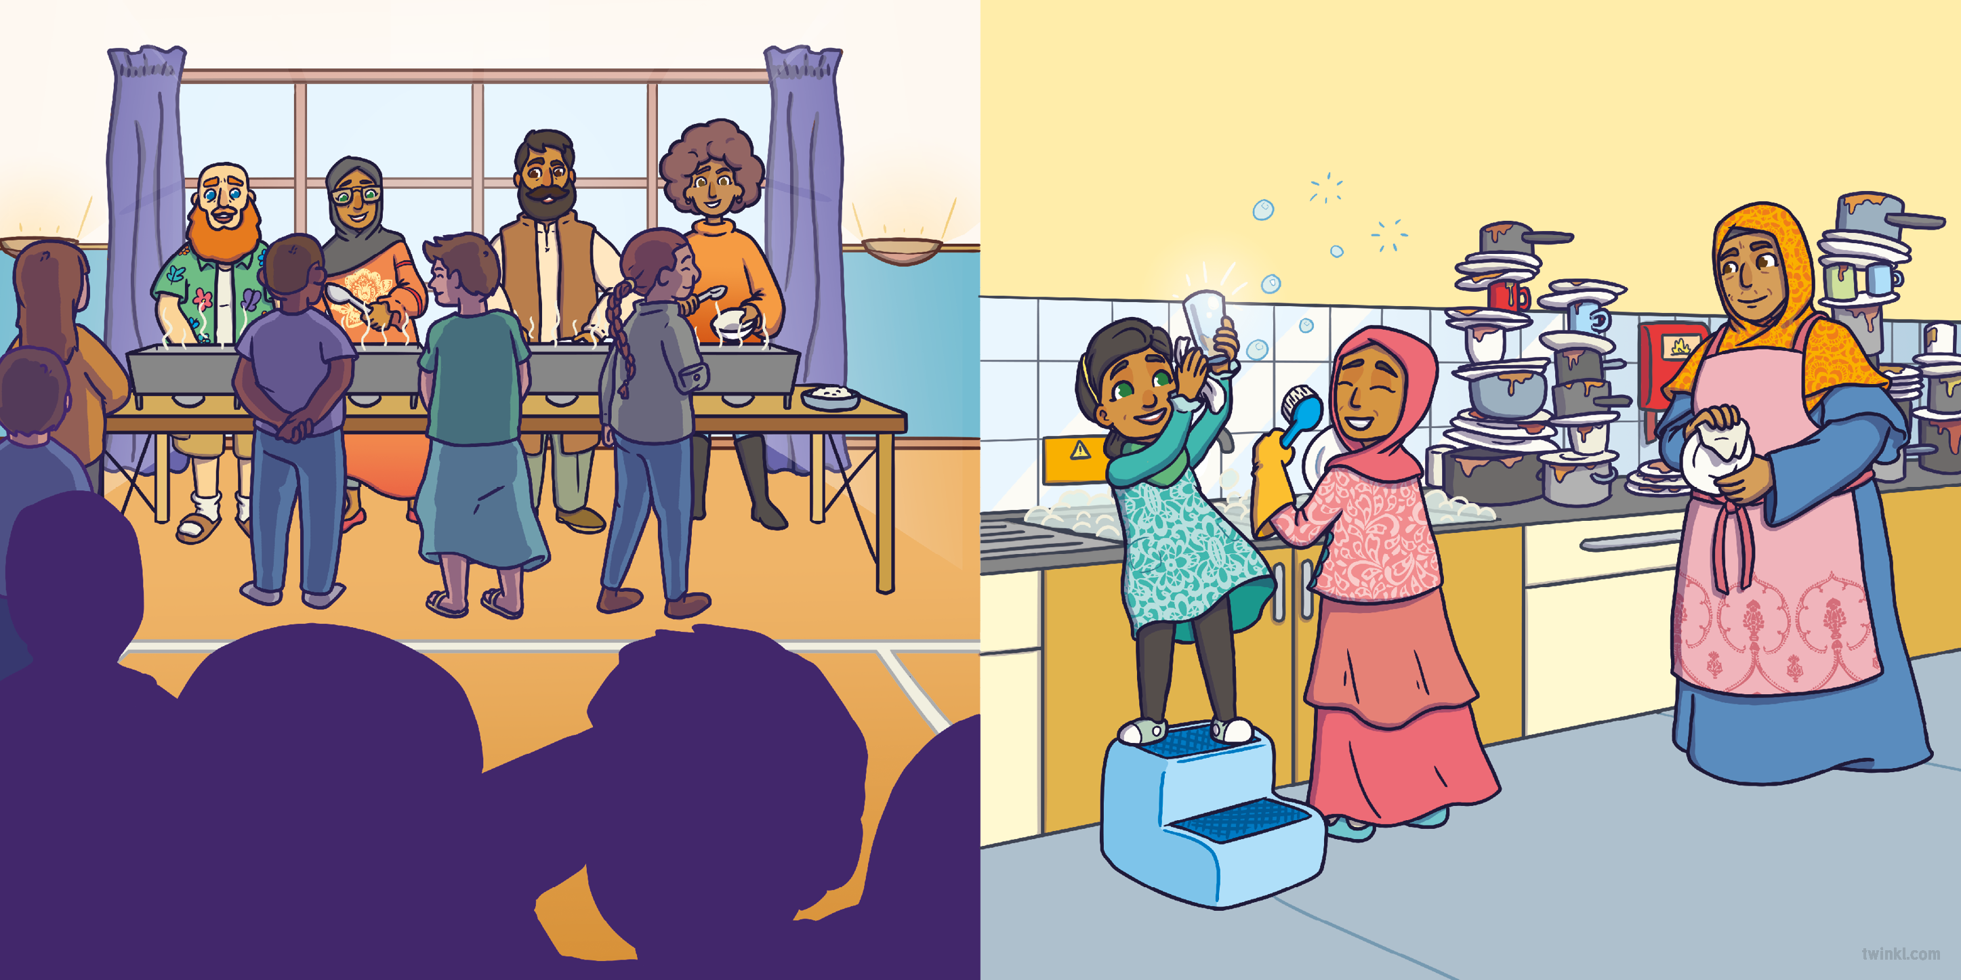
Meanwhile, Rameena and Zenab tackled the huge mountain of washing-up.
Mum and Dad worked with the other volunteers, serving food to lots of hungry people.
“Oh, thank you,” said Mrs Hussain.
“You’ve all been so helpful!”

Slide 9
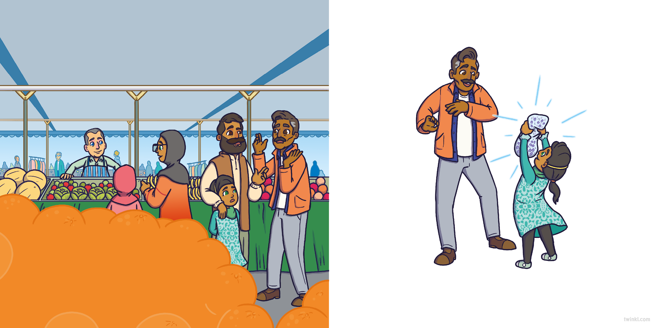
That afternoon, the family went shopping for everything they needed for their Eid celebrations. At the market,
they bumped into Dad’s friend, Tariq.
“Don’t worry,” said Rameena. “We can give you some of ours.”
“Is everything alright?” asked Dad.
“I’m OK,” said Tariq. “I just need some raisins to make my sheer khurma but they’ve sold out!” he said.
“Oh, thank you,” said Tariq. “That’s very generous. Sheer khurma is my son’s favourite!”

Slide 10
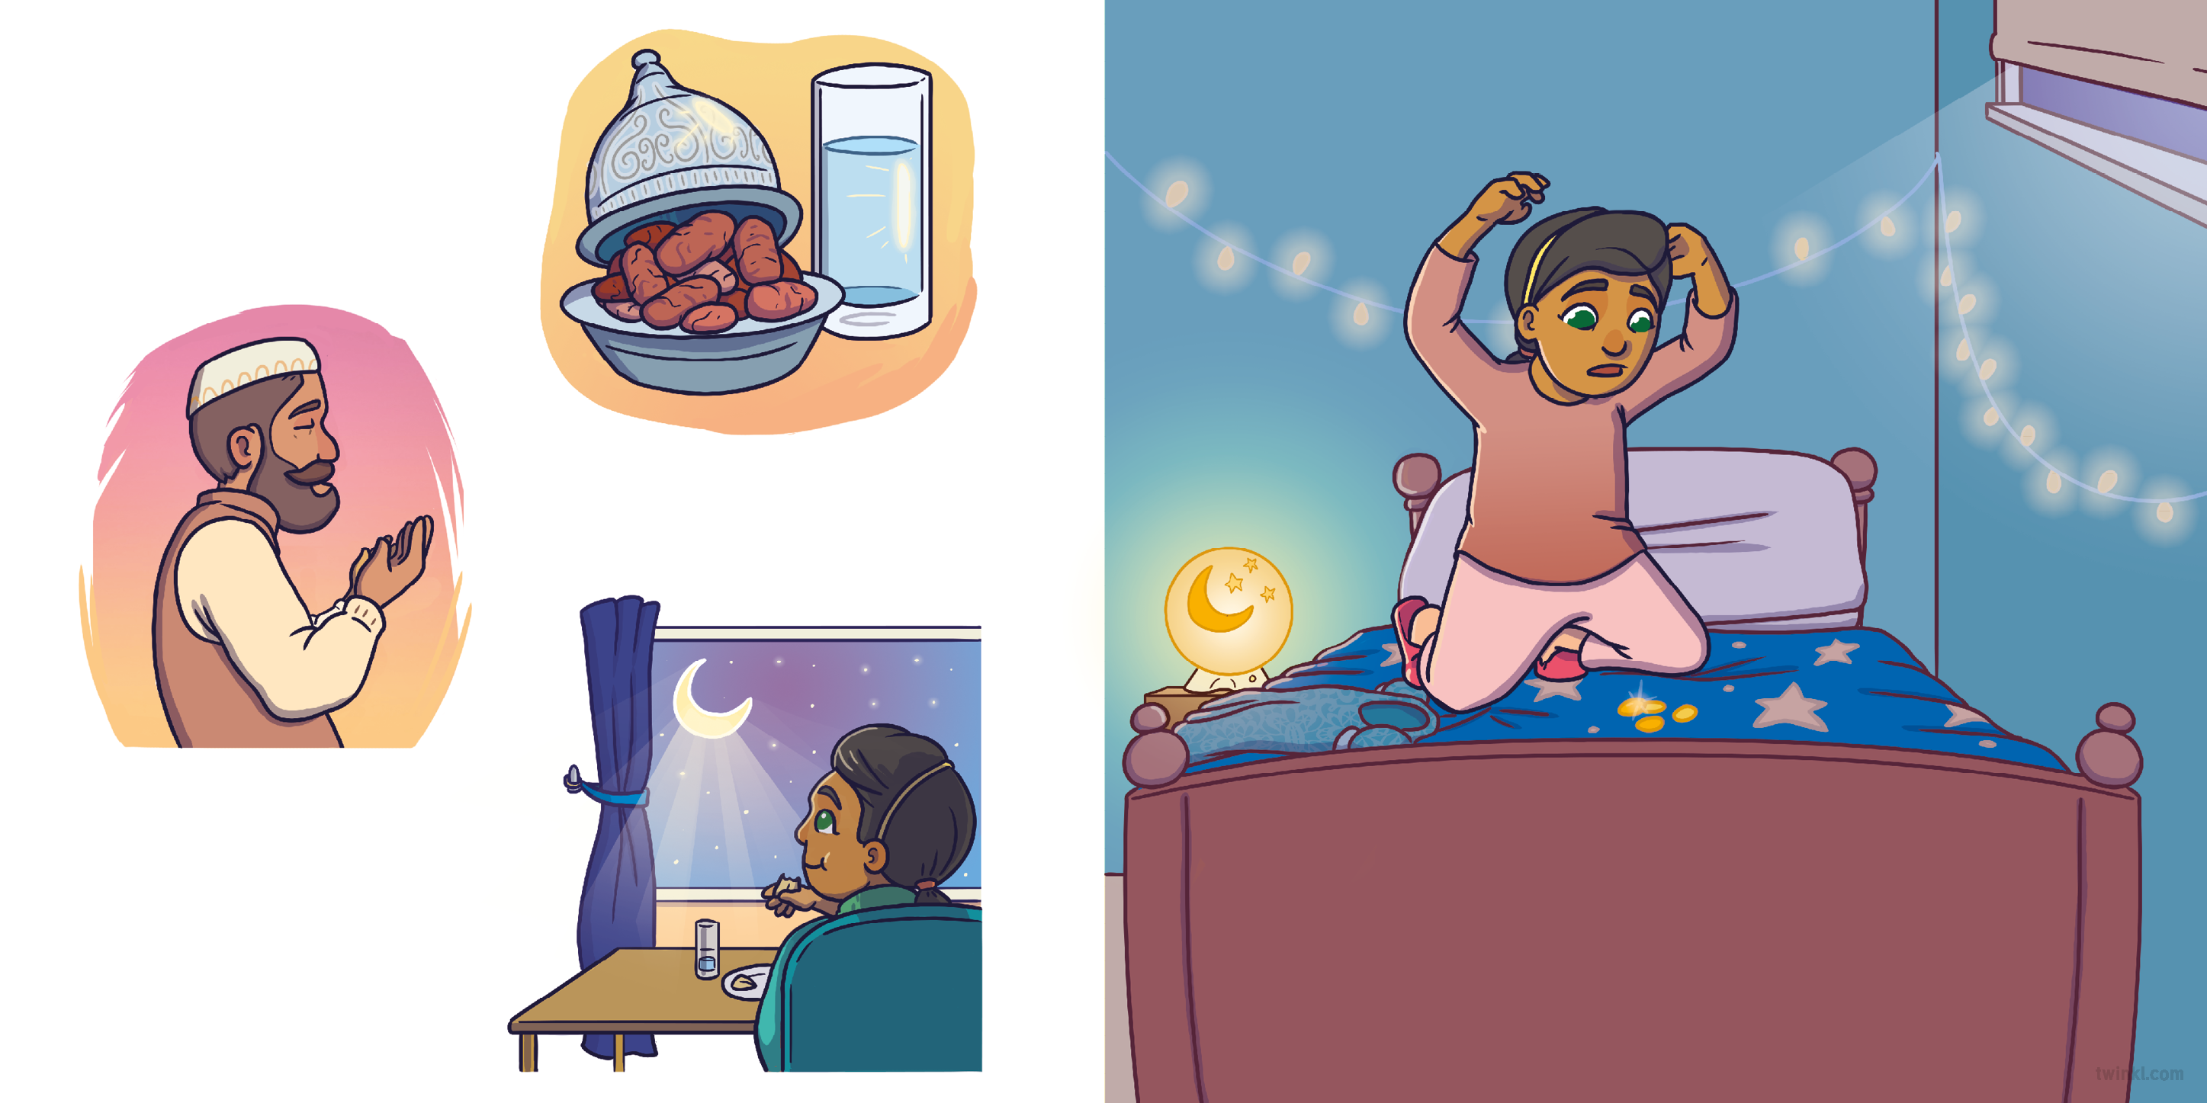
As the sun started to set,
it was time for Iftar. Mum, Dad and Zenab broke their fast with dates and water.
That night, Rameena went upstairs and got ready for bed.
Then, the family said the Maghrib prayer together.
As they all ate dinner, Rameena gazed at the crescent moon.
‘Oh no,’ she thought. ‘I’ve been so busy, I forgot to find someone to give my money to!’ She settled down to sleep feeling disappointed.

Slide 11
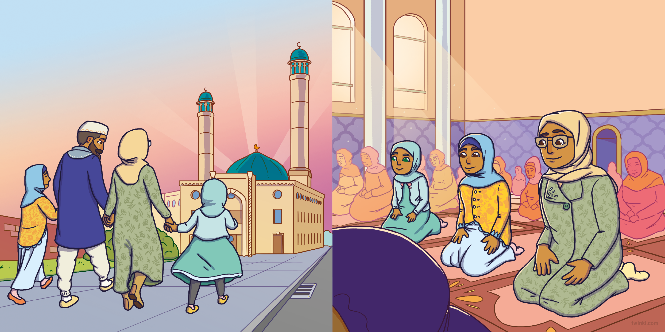
The next morning was the first day of Eid. Mum, Dad, Rameena and Zenab went to mosque, dressed in their special new clothes.
Inside the mosque, Rameena prayed.
“Allahu Akbar,” the imam said.
“Allahu Akbar,” everyone replied.

Slide 12
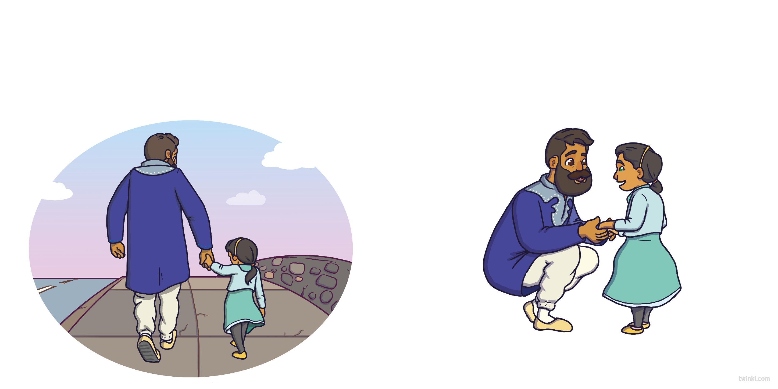
On the way back home, Dad noticed that Rameena seemed quieter than normal. “What’s wrong?” he asked.
“What are you talking about?” said Dad, surprised. “You watered Pam’s garden for her. Then you washed up all those plates for Mrs Hussain. And it was your idea to share our raisins with Tariq. You’ve given your time, your help and your love. You don’t have to give money to help others.”
“I am excited that it’s Eid,” she said, “I’m just sad that I didn’t get to give to others like my calendar said.”
Rameena felt better as she realised Dad was right.

Slide 13
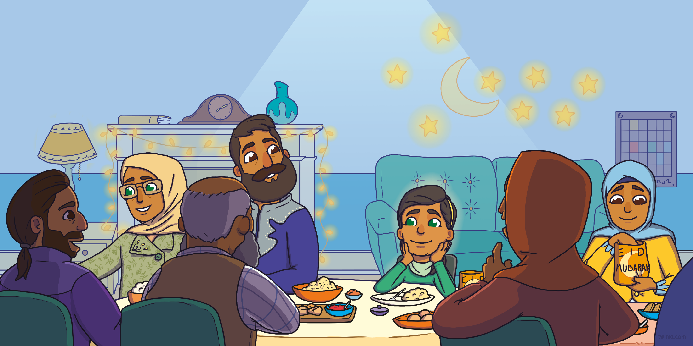
That night, Rameena and her family were joined by grandparents, uncles, aunts, cousins and friends. They had all brought food, sweets
and gifts for the big celebration.
Rameena smiled as she enjoyed a huge feast with the people she loved.

Slide 14
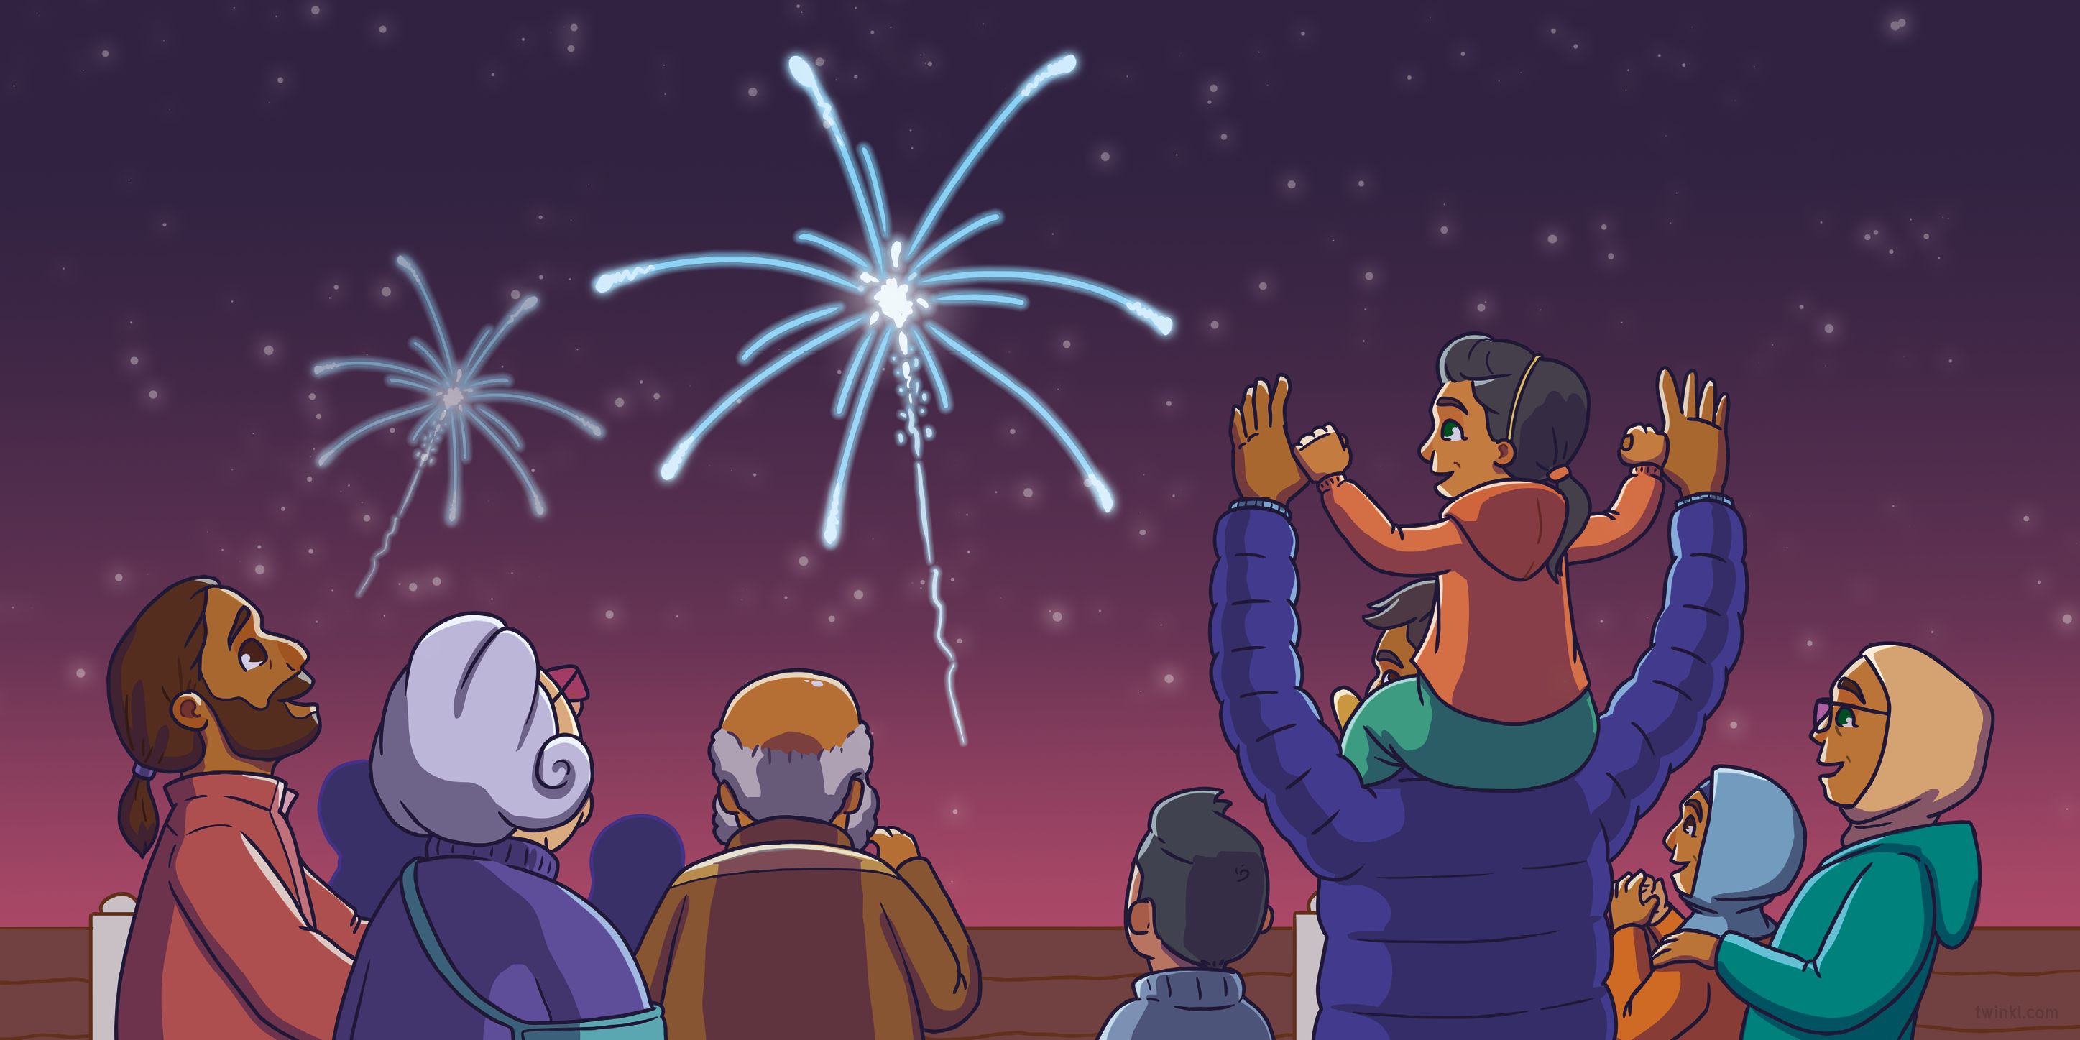
After the meal, everyone made their way outside for the fireworks. They all gasped as they watched the colourful explosions.
“Eid Mubarak!” Rameena shouted happily.
“Eid Mubarak!” everyone replied.

Slide 15


Slide 16


